Slide 1
Reinventing the Internet to make it Safer
CS35L Fall 2014 presentations
Theodore Nguyen

Slide 2
Abstract
The internet was not created with security in mind; programmers have had to incorporate security in their code
The design of the internet has not changed, and still contains these security flaws, but it is not feasible to start from scratch
DARPA’s Clean Slate program modeled building systems, clouds, and networks with security in mind – kind of like starting over with a clean slate

Slide 3
Outline
Internet background
Oldness of computer systems
Security breaching due to programming mistakes
DARPA’s Clean Slate program
Thoughts and Conclusion

Slide 4
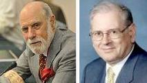
Internet Background
Vint Cerf, while doing his Ph.D at UCLA, met Robert Kahn, both working on the ARPANET project
The two came together in a hotel conference room and laid the foundations and backbone of the Internet which still exist today
More technically, the two created the Transmission Control Protocol (TCP) and the Internet Protocol (IP), which made up the Internet Protocol Suite

Slide 5
Internet Background
The two published their findings in their paper “A Protocol for Packet Network Intercommunication”
The Internet Protocol Suite consists of four layers: link, internet, transport, and application
TCP made up the transport layer, while IP made up the internet layer

Slide 6
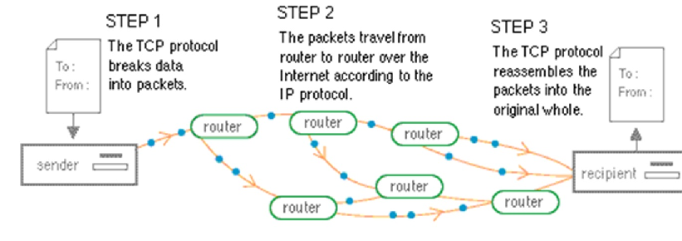
Internet Background
The TCP fragments a file before sending it, and once it is received by the other host, reassembles the file to its original form
The IP handles the transfer of the data, sending it to a specific IP address in the most efficient manner

Slide 7
Oldness of Computer Systems
This same Internet concept has formed the backbone of the Internet today, despite all of our advances
The concept was not created with security in mind, but with cost-effectiveness in mind
  They had no way to anticipate the future advances, and costs were high at the time

Slide 8
Incorporating Security
Because the Internet was not designed with security in mind, the programmer must accommodate for security in his code
However, a small programming mistake could easily make a system insecure
The lack of security design on the system means the programmer must intricately implement security

Slide 9

The Heartbleed Bug
Disclosed in April 2012 after two yrs
Serious vulnerability found in the OpenSSL software library
  Used by several high profile companies, such as Amazon, Google, etc.
Compromised sensitive material for all users of OpenSSL, including consumer passwords, and private information used in impersonation

Slide 10

The Shellshock bug
Disclosed in Sept 2014, after 22 years
Another serious vulnerability, found in GNU’s bash shell allowing remote attackers to run commands on a system
Affects major businesses as well, but more so any individual or corporation that uses GNU’s bash shell

Slide 11
Incorporating Security
Nevertheless, these are two very serious and recent examples of how leaving security solely up to the programmer poses a serious risk
These two bugs affect > 50% of the internet
A small vulnerability in software can have catastrophic widespread results if the software is very popular
So, its worth wondering whether an Internet with a security backbone in mind can fare well

Slide 12

DARPA’s Clean Slate Program
Five years ago, DARPA started its Clean Slate Program
The latter essentially had the idea of building computers over, but with security – not performance – in mind integrated in backbone

Slide 13
DARPA’s Clean Slate Program
Clean Slate consisted of two projects:
  (1) Crash (Clean-Slate design of resilient, adaptive, secure hosts): aimed at making systems that were more resilient and could repair itself upon being breached
  (2) MRC (Mission-oriented Resilient Clouds): essentially was the same thing as Crash, but applied to networking and cloud computing

Slide 14
DARPA’s Clean Slate Program
Active Authentication: A separate project at DARPA that analyzes human behavior to authenticate the user, rather than just have a one time authentication – the machine is aware of the user
  Appears to be a good deterrent of stolen passwords
Clean Slate, on the other hand, makes the machine aware of its environment

Slide 15
DARPA’s Clean Slate Program
Because it is infeasible to replace the existing internet infrastructure with one built with security in mind, developing a methodology to use existing software with more security settings is more plausible
One program part of the Crash project is called “Clean Slate Trustworthy Secure Research and Development” (aka Custard)

Slide 16
DARPA’s Clean Slate Program
Custard allows software and other technologies to run in a safer mode to choose who had permissions for which operations
  Can completely eliminate Buffer Overflow attacks
There has been increased demand for Custard in private companies, nonprofits, and academia research institutions

Slide 17
My Thoughts
The article enlightened me to the fact that the Internet in its creation was wholly insecure
I agree that internet security is a very important topic, especially in today’s digital age
  Internet security is directly related to our personal privacy, since all our information is now stored electronically

Slide 18
Conclusions
It is definitely infeasible to replace the current Internet infrastructure where it is right now
However, more than likely, there will be a higher demand for long-term security as everything becomes more technologically advanced, and more online

Slide 19
Citations
http://heartbleed.com/
https://www.kb.cert.org/vuls/
http://bits.blogs.nytimes.com/2014/12/02/reinventing-the-internet-to-make-it-safer/?_r=0
http://www.yale.edu/pclt/COMM/TCPIP.HTM
https://shellshocker.net/
http://www.billslater.com/internet/

